Slide 1


Denoising Diffusion-Based Evolutionary Algorithms
Supervisor: Günther Raidl
Joan Salvà Soler – 12223411
Master Thesis Defense

Slide 2
ML for Combinatorial Optimization (CO)
CO -> find an optimal solution from a discrete set (e.g., routes, schedules, assignments)
Solution methods
  Exact -> Mathematical Programming, Constraint Programming
  Heuristic -> Greedy Heuristics, Local Search procedures
  Metaheuristic -> e.g. Evolutionary Algorithms (EA)
  Machine Learning
    Supervised, Unsupervised, Reinforcement Learning approaches
    End-to-end learning, Learning configurations, ML for algorithmic decision-making…

Slide 3
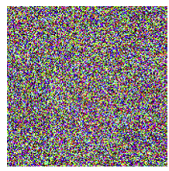
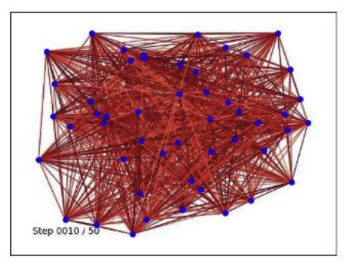
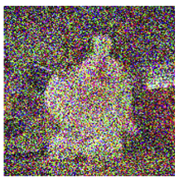
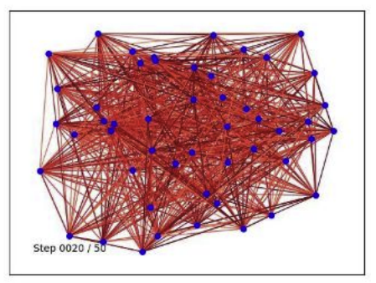
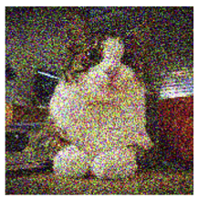
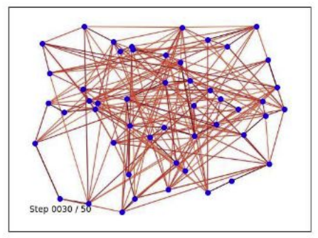
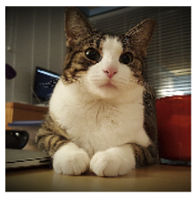
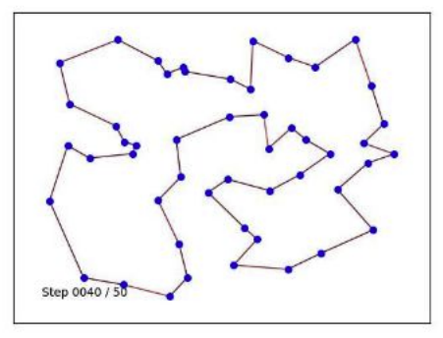
Denoising Diffusion Models for CO
Denoising Diffusion Models, a new generative modeling appraoch for CO
Graph Neural Networks (GNN) are a foundational architecture in ML for CO -> embedded within DDMs
DIFUSCO^{[a]}:
  Use a Denoising Diffusion Model (GNN backbone) to denoise a random graph into a solution
  Multi-modality -> multi-sampling leads to distinct solutions
  Train in supervised manner using solver-generated labels
  Parallel generation of solutions thanks to GPU acceleration
[a] Sun, Z., & Yang, Y. (2023), NeurIPS, https://arxiv.org/abs/2302.08224

Slide 4
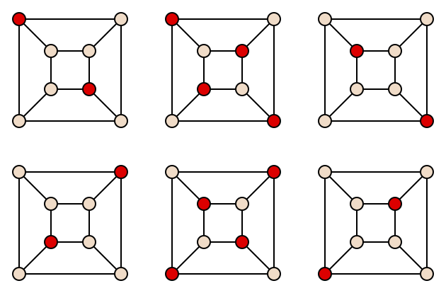
Focus Problem: Maximum Independent Set (MISP)
Definition: Find a largest set of non-adjacent nodes in a graph
A good benchmark:
  Common in ML for CO literature
  Simple definition, but NP-hard
KaMIS^{[b]} is the state of the art solver:
  C++
  Combines exact methods with heuristics, no ML
[b] Lamm et al. (2017), J. Heuristics, https://doi.org/10.1007/s10732-017-9337-x

Slide 5
Problem Statement
Limitations of DIFUSCO:
  Need post-processing heuristics for feasibility / quality (often problem-dependent)
  Lack general search methods to complement its strong multi-modal generative power
Goal
  Combine strong multi-modal generative power of Diffusion Models
  With methods that effectively explore the solution space (Evolutionary Algorithms)
  Leverage GPU computation for parallelization of population operators, promising a scalable approach for large instances

Slide 6
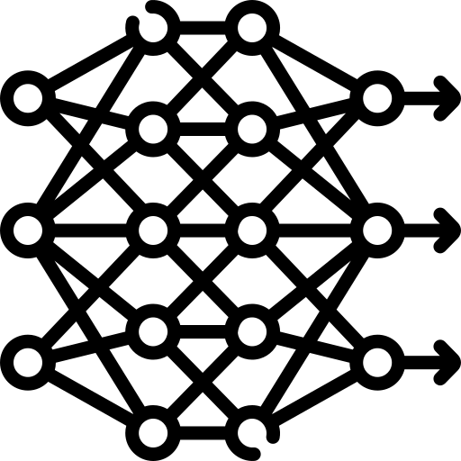
Methodology: DDEA
Diffusion-Based Initialization
Problem instance
Problem instance
Denoising Diffusion
Trained on high-quality solutions
. . .
Diffusion-Based
Initialization
Problem instance
Initialize
Diverse population of solutions
Repeat N generations
Repeat N generations
Crossover
Diffusion-Based
Crossover
Diffusion-Based Recombination
Select
Select
Replace
Replace
Mutate
Mutate
Problem instance
+
Denoising Diffusion
+ Conditioning
Trained on “optimal recombinations”
High-quality recombined solutions
Two solutions to combine
Solution
Solution
Evolutionary Algorithm
DDEA

Slide 7
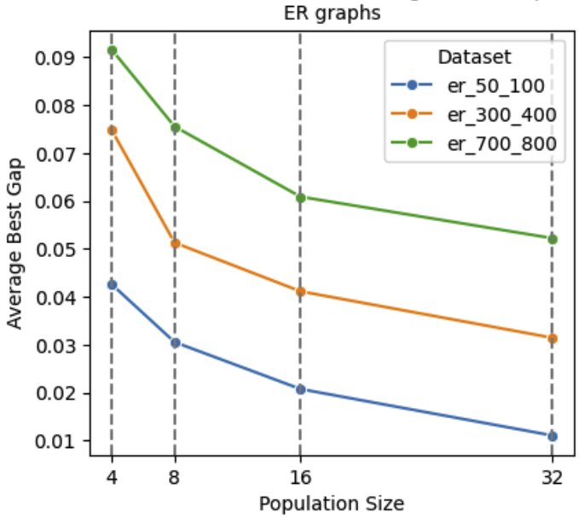
Diffusion-Based Initialization
Sample a population of initial solutions from a pre-trained DIFUSCO model
Multi-modal property ensures diversity
Decode node probabilities into feasible solutions using a probability-biased greedy decoding
  Sort by highest probability, and sequentially add to the IS respecting feasibility
  Simple and the only problem-dependent component
Multi-modal property of DIFUSCO in action

Slide 8
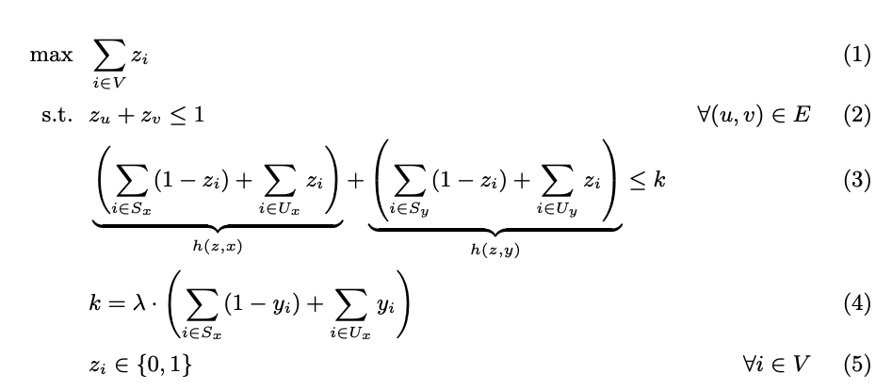
Diffusion-Based Recombination
Train with Imitation Learning from Expert Demonstrator
  use an ILP to generate offspring combining qualities from both parents
  Slow but high quality
We modify the DIFUSCO architecture to accept conditioning features
Train on in-distribution examples: real EA trajectiories with the optimized recombination
ILP for the expert demonstrator

Slide 9
Experimental Setup
MISP on Erdős-Rényi (ER) graphs:
  50-100 nodes
  300–400 nodes
  700-800 nodes
  1300-1400 nodes (OOD evaluation)
Metrics:
  Optimality gap to KaMIS solution = 1 – (KaMIS / x)
  Cost = size of the independent set
Settings
  Population size P = 16
  Generations G = 20
  Inference diffusion steps = 50

Slide 10
Baselines
DIFUSCO (multi-shot x4, x8, x32)
KaMIS (60s time limit)
Gurobi (timed to avg time of DDEA) solving a standard MIS model
Ablation variants:
  Randomized Greedy Initialization (RG Init) – replacing DIFUSCO initialization
  Consensus-Divergence Crossover (CDX) – replacing diffusion recombination

Slide 11
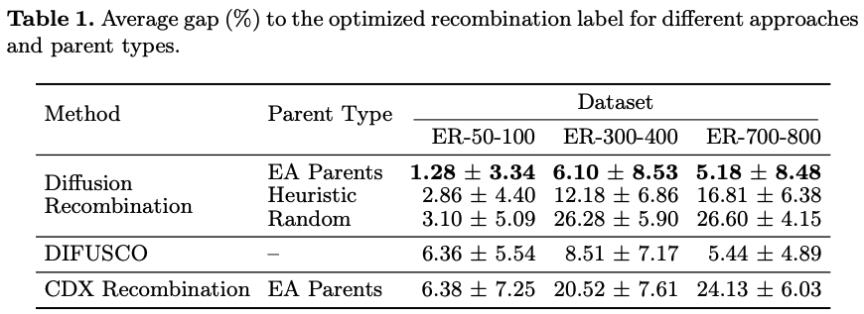
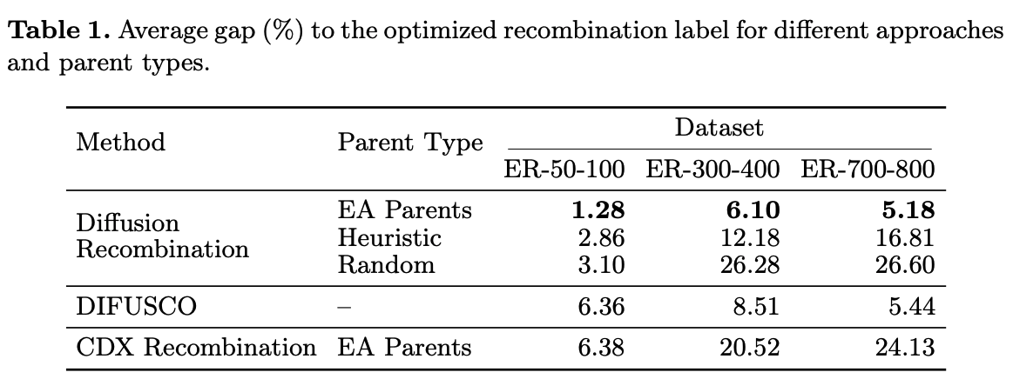
Diffusion Recombination Evaluation
  Diffusion Recombination effectively approximates the expert operator
  Clearly outperforms CDX
  Cost monotonicity -> better conditioning solutions increases offspring quality

Slide 12
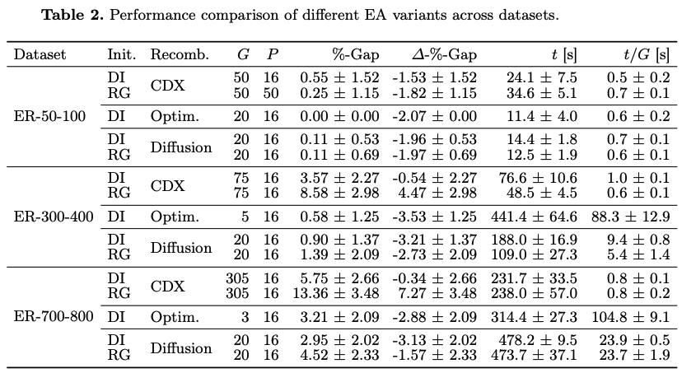
DDEA Ablation Studies
Full DDEA achieves performance comparable to the EA with expert optimized recombination, reducing runtime per generation drastically
Full DDEA clearly outperforms the ablations -> both diffusion operators are critical
Diffusion Recombination seems particularly important

Slide 13
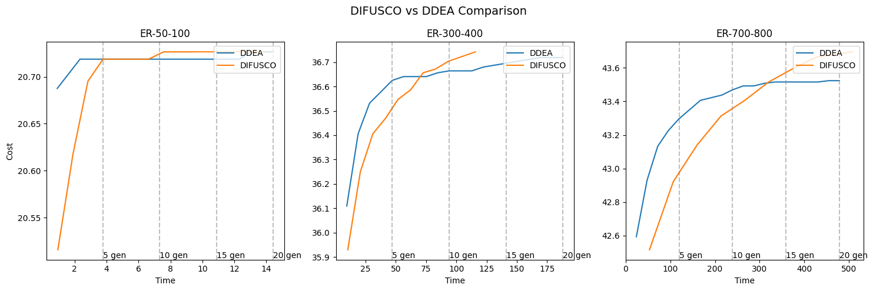
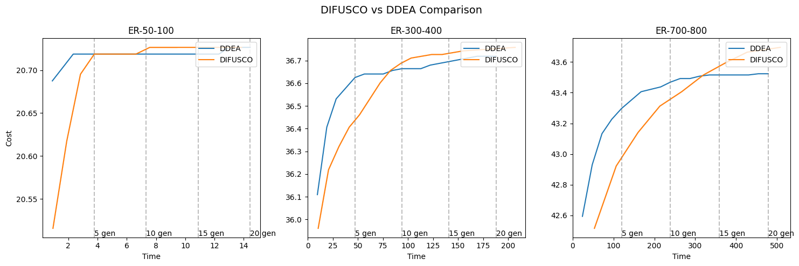
DDEA vs DIFUSCO Under Different Time Budgets
  DDEA demonstrates superior performance compared to DIFUSCO under reduced time budgets
  DDEA converges earlier, and around a worse average cost than DIFUSCO
  DIFUSCO surpasses DDEA in solution quality after a specific number of generations

Slide 14
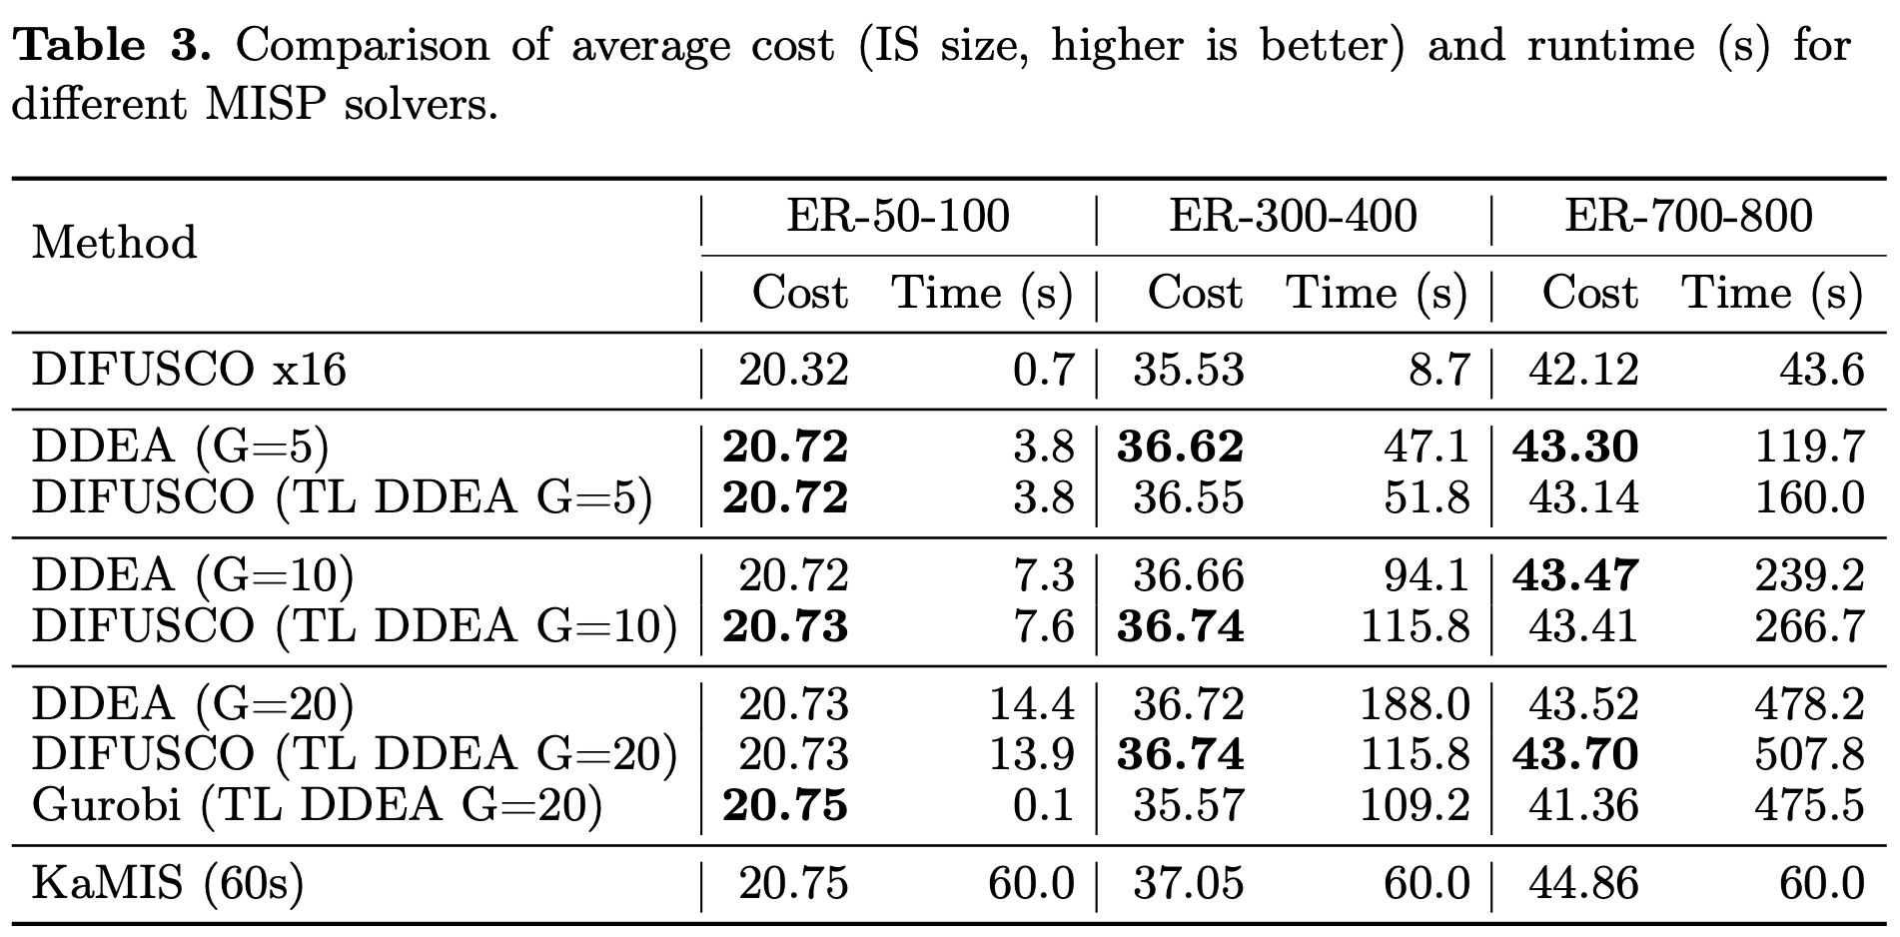
DDEA vs Other Solvers
  DDEA outperforms Gurobi on larger instances under same time budget
  DDEA does not beat KaMIS, which is the ground truth solver

Slide 15
Summary and Conclusion
Introduced DDEA: a Hybrid DDM + EA framework
  Key components: Diffusion Initialization and Diffusion Recombination
Results
  Beat DIFUSCO for small runtimes
  But converge earlier to a worse objective
  Beat Gurobi on large datasets with equal time budget

Slide 16
Summary and Conclusion
Limitations:
  Runtime (dominated by diffusion inference). GPU parallelization benefits still to exploit.
  Expensive Diffusion Recombination training data generation
Improvements:
  Expanded problem domains
  GPU parallelization optimization
  Cheaper training data generation pipeline
  Advanced Diffusion-CO architectures (T2T, DISCO)

Slide 17
Questions?

Slide 18
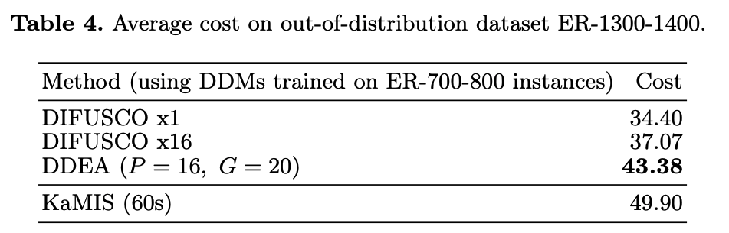
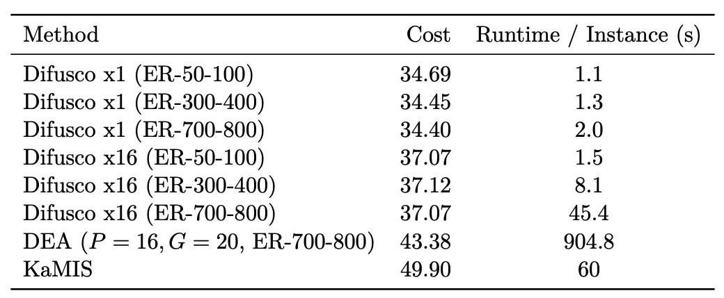
Out-of-Distribution Generalization
DIFUSCO struggles, multi-shot provides little improvement
Full DDEA generalizes much better
However, gap to KaMIS is much bigger compared to in-distribution evaluation

